Slide 1

RUNGTA COLLEGE OF DENTAL SCIENCES & RESEARCH
TITLE OF THE TOPIC : FUNDAMENTALS OF TOOTH PREPARATION
DEPARTMENT OF CONSERVATIVE DENTISTRY AND ENDODONTICS

Slide 2
Specific learning Objectives
At the end of this presentation the learner is expected to know ;
Core areas* | Domain ** | Category #
Enameloplasty Primary resistance form Primary retention form | COGNITIVE | MUST KNOW
Techniques Convinence form | PSYCHOMOTOR | NICE TO KNOW
Liners Bases varnish | AFFECTIVE | DESIRE TO KNOW
*Subtopic of importance
** Cognitive, Psychomotor or Affective
# Must know , Nice to know & Desire to know
( Table to be prepared as per the above format )

Slide 3
Table of Content
TOOTH PREPARATION
NEED FOR RESTORATION
OBJECTIVES OF TOOTH PREPARATION
EXTENT OF CARRIES
INFECTED DENTIN
AFFECTED DENTIN
TERMONOLOGIES OF TOOTH PREPARATION
TOOTH PREPARATION ANGLE
GV BLACK CLASSIFICATION
STAGES AND STEPS IN TOOTH PREPARATION
TECHNIQUES
OBJECTIVES
REFERENCES

Slide 4
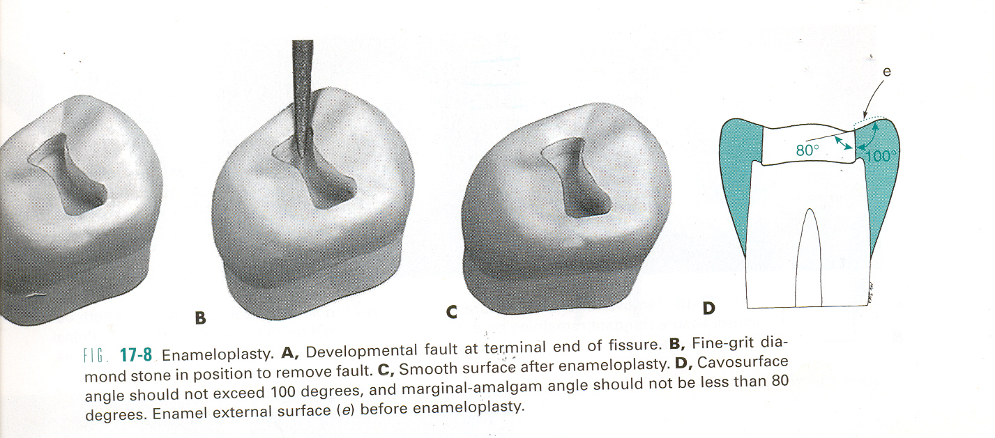
Enameloplasty
The procedure of reshaping the enamel surface with suitable rotary cutting instruments is termed enameloplasty.
Enameloplasty does not extend the outline form.

Slide 5
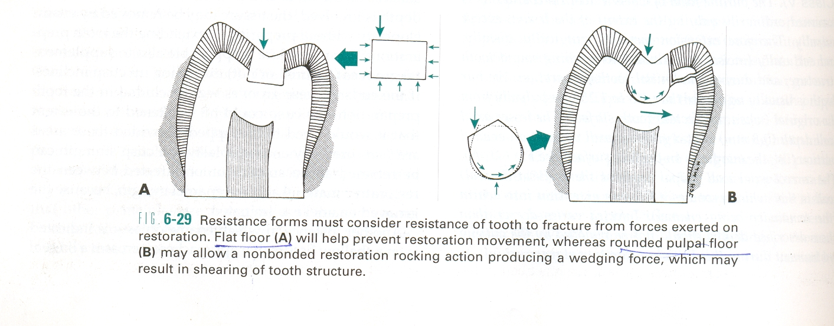
Primary Resistance Form
It is defined as that shape or placement of the preparation of walls that best enable both the restoration and the tooth to withstand, without fracture, masticatory forces delivered principally in the long axis of the tooth.

Slide 6
Principles
To use the box shape with a relatively flat floor.
To restrict the extension of the external walls.
To have slight rounding of internal line angles.
In extensive tooth preparations, to cap weak cusps and envelope or include enough of a weakened tooth within the restoration.
To provide enough thickness of restorative material to prevent its fracture under load; and
To bond the material to tooth structure when appropriate.

Slide 7
Features
Relatively flat floors
Box shape
Inclusion of weakened tooth structure
Preservation of cusps and marginal ridges
Adequate thickness of restorative material
Reduction of cusps for capping when indicated

Slide 8
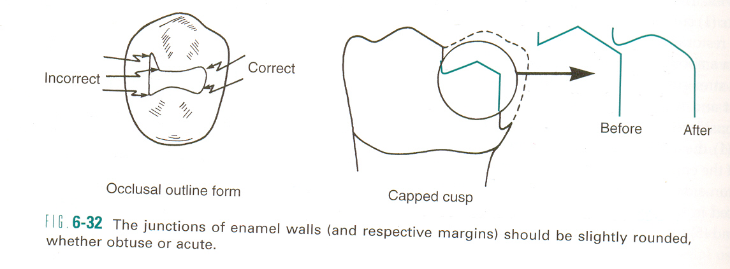
Rounded internal line angles

Slide 9
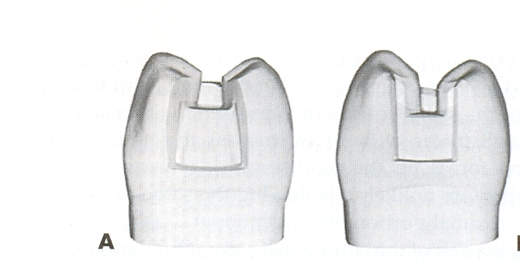
Primary Retention Form
It is that shape or form of the conventional preparation that resists displacement or removal of the restoration from tipping or lifting forces.
For amalgam For inlay

Slide 10
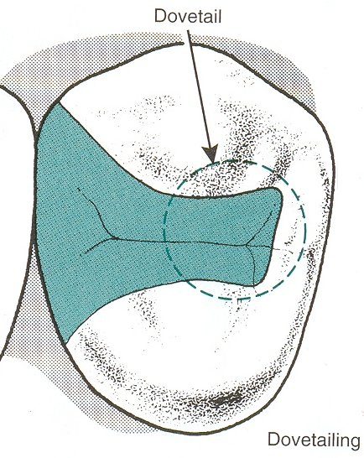
Principles
Retention needs are related to the restorative material used, the principles of primary retention form vary depending on the material used.
For amalgam in class I & II conventional preparations - retention by
- developing external tooth walls that converge occlusally.
- occlusal dovetail in class II

Slide 11
For composite
- retained in the tooth by micromechanical bond that develops between the material and etched and primed prepared tooth structure.
- in class V composite tooth preparation on the root surface, groove retention in addition to the use of a bonding system.
- many composite tooth preparation have beveled or flared enamel marginal configuration.

Slide 12
For cast metal intracoronal restorations
- it rely primarily on almost parallel vertical walls or an appropriate small angle of divergence (2 to 5 degrees per wall) from the line of draw that will enhance retention form.
- the degree of divergence primarily depends on the length of prepared walls.
- occlusal dovetail.

Slide 13
Convenience Form
Convenience form is that shape or form of the preparation that provides for adequate observation, accessibility, and ease of operation in preparing and restoring the tooth.
In preparations for gold foil, convenience form includes establishing convenience points for the starting of foil condensation.
The occlusal divergence of vertical walls for class II cast restorations may be considered as convenience form.
Extending proximal preparations beyond proximal contacts is also a convenience form.

Slide 14
Final tooth preparation stage
Step5: Removal of any remaining infected dentin
and/or old restorative material, if indicated
Step6: Pulp protection, if indicated
Step7: Secondary resistance & retention form
Step8: Procedures for finishing external walls
Step9: Final procedures: cleaning, inspecting,
sealing

Slide 15
Removal of any remaining enamel pit or fissure, infected dentin, and/or old restorative material is the elimination of any infected carious tooth structure or faulty restorative material left in the tooth after initial tooth preparation.

Slide 16
Any remaining old restorative material should be removed if any of the following conditions are present
- the old material may affect negatively the esthetic result of the new restoration.
- the old material may compromise the amount of anticipated needed retention.
- radiographic evidence indicates caries is under the old material.
- the tooth pulp was symptomatic preoperatively.
- the periphery of the remaining old restorative material is not intact.

Slide 17
Techniques
After proper initial tooth preparation, if a small amount of infected carious material remains, only this material should be removed , leaving a rounded, concave area in the wall.
In large preparations with extensive soft caries, the removal of infected dentin may be accomplished early in the initial tooth preparation.
If patient has numerous teeth with extensive caries, then the removal of caries is indicated early in tooth preparation.

Slide 18
Large areas of soft caries usually are best removed with spoon excavators.
Removal of harder, heavily discolored dentin with the use of a round carbide bur, in a high speed handpiece, with air coolant and slow speed.
Removal of remaining old restorative material, when indicated, also is accomplished with use of a round carbide bur, at slow speed with air or air-water coolant.

Slide 19
Pulp protection, if indicated
Liners and bases – to protect pulp or to aid pulpal recovery or both
When the thickness of the remaining dentin is minimal, heat generated by injudicious cutting can result in a pulpal burn lesion, an abscess formation or pulpal necrosis.

Slide 20
Other pulpal irritants
Some ingredients of various materials
Thermal changes conducted through restorative materials
Forces transmitted through materials to the dentin
Galvanic shock; and
The ingress of noxious products and bacteria through microleakage.

Slide 21
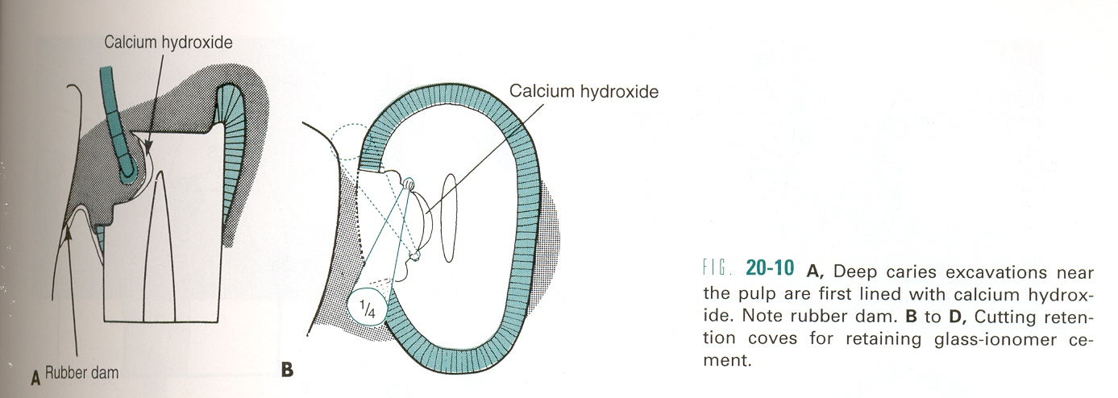
Selection of liner or base should be based on an assessment of the anatomic, physiologic, & biologic response characteristics of the pulp, as well as physical & chemical properties of the considered material.

Slide 22
Liners
Liners – those volatile or aqueous suspensions or dispersions of zinc oxide or calcium hydroxide that can be applied to a tooth surface in a relatively thin film and are used to affect a particular pulpal response.
Liners also may provide
A barrier that protects the dentin from noxious agent
Initial electrical insulation, and
Some thermal protection.

Slide 23
Bases
Bases – those cements commonly used in thicker dimensions beneath permanent restorations to provide for mechanical, chemical and thermal protection of the pulp.
Examples – zinc phosphate, zinc oxide-eugenol, calcium hydroxide, polycarboxylate, glass ionomer.
Liners and bases in exposure areas should be applied without pressure.
Level to which a base is built should never compromise the desired tooth preparation depth, resulting in inadequate restorative material thickness.

Slide 24
Varnish
Tooth varnish is a solution liner, used to seal dentinal tubules & was placed on all preparation walls for amalgam & on dentinal walls of tooth preparation for cast gold, but was not used for composite.
The varnish prevented penetration of materials into the dentin & helped prevent microleakage.
It also reduces postoperative sensitivity.

Slide 25
Secondary resistance and retention form
These are of two types
1. Mechanical features – retention locks, grooves &coves;
groove extensions;
skirts;
beveled enamel margins;
pins, slots, steps and
amalgampins.
2. Placement of Etchant, Primer, or Adhesive on prepared walls –
enamel wall etching
dentin treatment

Slide 26
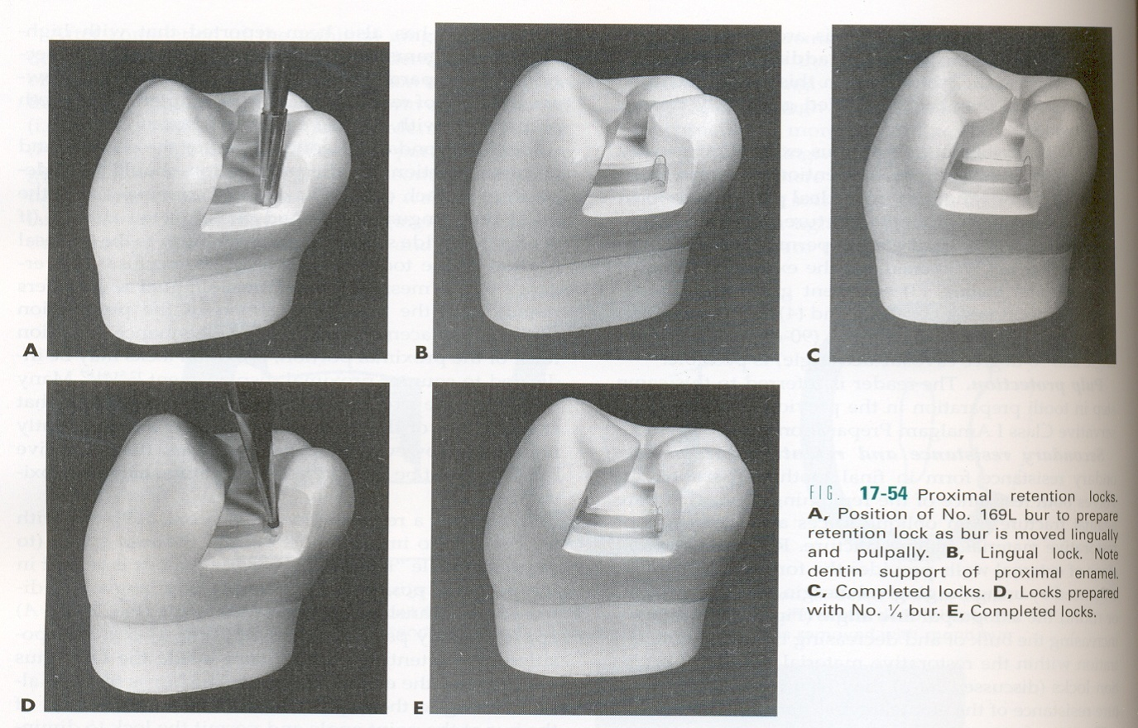
Mechanical features
Retention locks, grooves, and coves- vertically oriented retention locks and retention grooves are used to provide additional retention for proximal portions of some tooth preparations

Slide 27
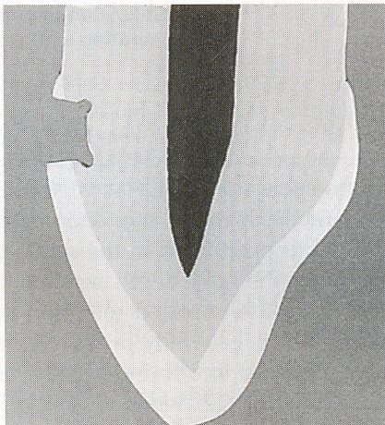
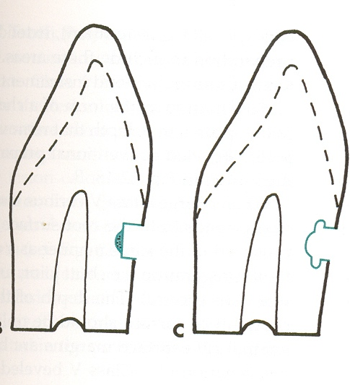
Horizontally oriented retention grooves are prepared in most classes III & V preparation for amalgam & in some root surface preparation for composite
Groove for amalgam for composite

Slide 28
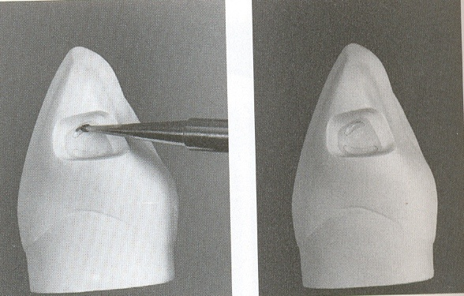
Retention coves are appropriately placed undercuts for the incisal retention of class III amalgams, occlusal portion of some amalgam restorations, some class V & occasionally for facilitating the start of insertion of certain gold foil restoration.
Incisal retention cove

Slide 29
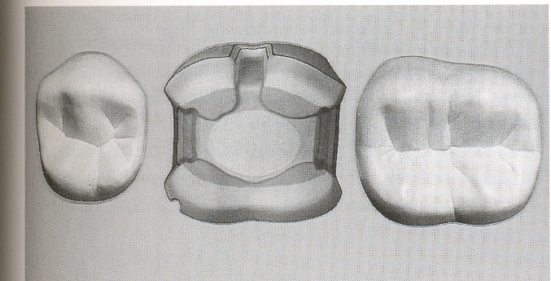
Groove extensions- additional retention of the restorative material may be obtained by arbitrarily extending the preparation for molars onto the facial or lingual surface to include a facial or lingual groove.

Slide 30
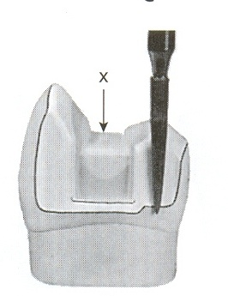
Skirts- skirts are preparation features used in cast gold restorations that extend the preparation around some, if not all, of the line angles of the tooth.

Slide 31
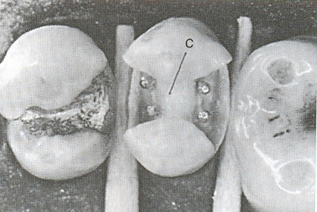
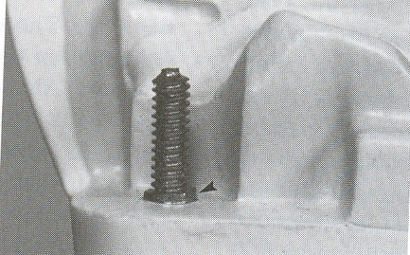
Beveled enamel margins
Pins, slots, steps & amalgampins- the use of pins & slots increases both retention & resistance forms. Amalgampins & steps also improve retention form, but not to the extent of pins or slots.

Slide 32
Placement of Etchant, Primer, or Adhesive on prepared walls
Both enamel and dentin surfaces may be treated with etchants and/or primers for certain restorative procedures.
Enamel wall etching- enamel walls are etched for bonded restorations that use porcelain, composite, or amalgam materials.
Dentin treatment- for bonded porcelain, composite, or amalgam materials.

Slide 33
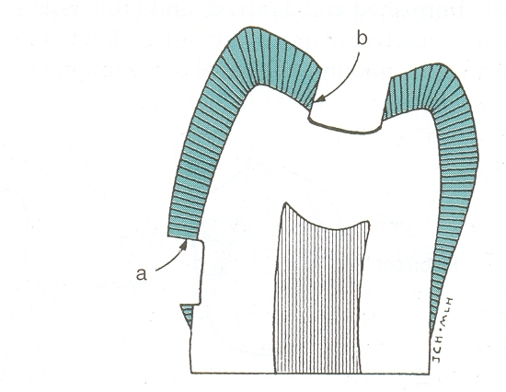
Procedures for finishing the external walls of the tooth preparation
Definition – finishing the preparation walls is the further development, when indicated, of a specific cavosurface design and degree of smoothness or roughness that produces the maximum effectiveness of the restorative material being used.
strongest enamel margin

Slide 34
Objectives
Create the best marginal seal possible between the restorative material and the tooth structure,
Afford a smooth marginal junction, and
Provide maximum strength of both the tooth and restorative material at and near the margin.

Slide 35
Factors to be considered
The direction of enamel rods,
The support of the enamel rods both at the DEJ and laterally,
The type of restorative material to be placed in the preparation,
The location of the margin, and
The degree of smoothness or roughness desired.

Slide 36
Final procedures: cleaning, inspecting and sealing
Final procedures in tooth preparation include the cleaning of the preparation, inspecting the preparation and applying a sealer when indicated.
Includes removing all chips and loose debris etc
Drying the preparation

Slide 37
TAKE HOME MESSEGE/ FOR THE TOPIC COVERED (SUMMARY)
A cavity preparation is determined by many factors and each time a cavity is to be restored each of these factors must be assessed.
If the principles of cavity preparation are adhered to, the success of restoration increases
The factors that should be considered before initiating a cavity preparation are as follows :
Extent of carries
Occlusion
Pulpal involvement
Esthetics
Patients age
Operational skills

Slide 38
Question & Answer Session
1.What are the various steps in cavity preparation?
2. Features of resistance and retention form?

Slide 39
REFERENCES
NAME OF THE BOOK WITH EDITION AND PAGE NUMBERS
ARTICLE ARE TO BE MENTIONED IF NEEDED
ART AND SCIENCE OF OPERATIVE DENTISTRY
CLINICAL OPERATIVE DENTISTRY
TEXTBOOK OF PRECLINICAL CONSERVATRIVE DENTISTRY
PRINCIPLES AND PRACTICE OF OPERATIVE DENTISTRY

Slide 40
THANK YOU

